Slide 1

Project 3

Slide 2

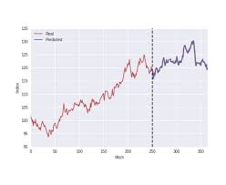
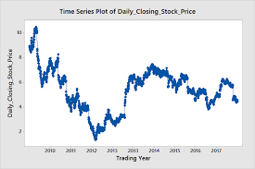
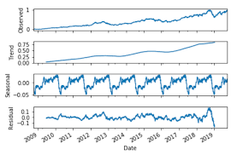
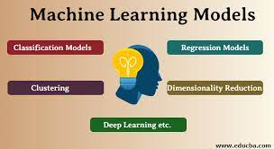
Develop Machine Learning Framework
Exogenous Data
Target Data
Multi-Variate Data
Machine Learning
Forecast
Goal: Run Experiments with data engineering and ML to develop forecasting methods

Slide 3


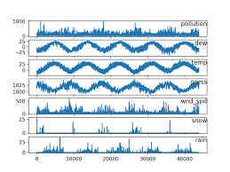
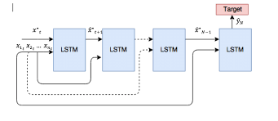
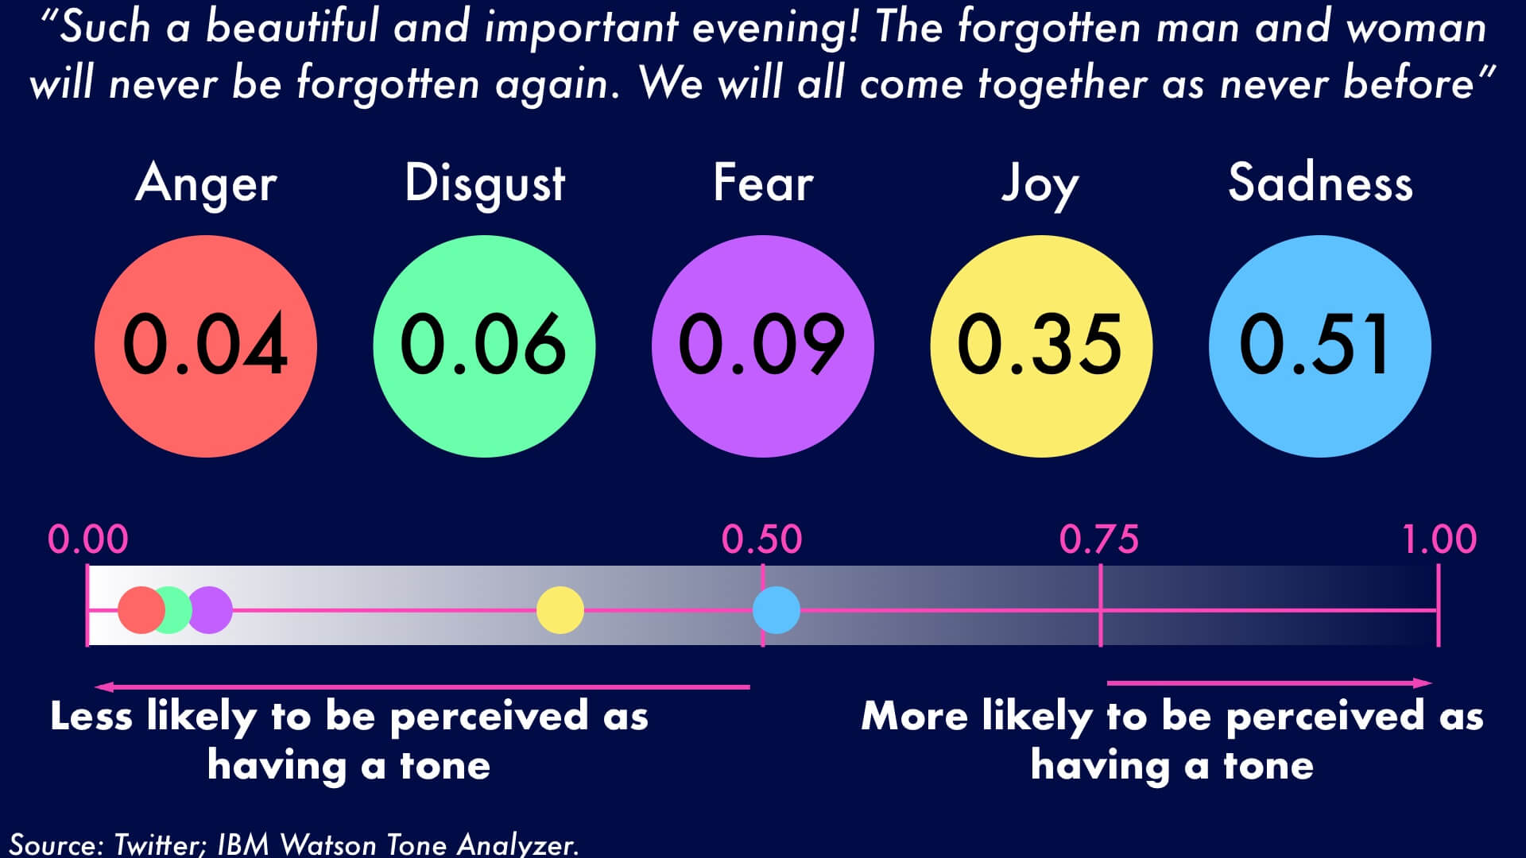
Project 3 Baseline
NewsAPI
Alpaca Stock
Multi Variate LSTM
Visualize PX + Panel
IBM Tone

Slide 4
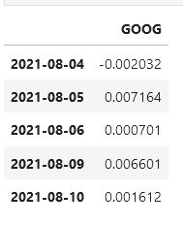
Alpaca Data
Pick a Stock
Get closing prices for last 30 days
Compute log of price change
Target = Log (y_{t}/y_{t-1})
Clean up and format

Slide 5
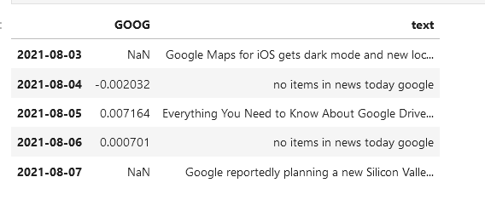
News API
Get News Articles on Company in question
Combine “Title”, “Description” and “Content”
Combine with Closing stock Price and index date
Problems:
Only last 30 days of data for free
Often no news on topic
New on non-trading days

Slide 6
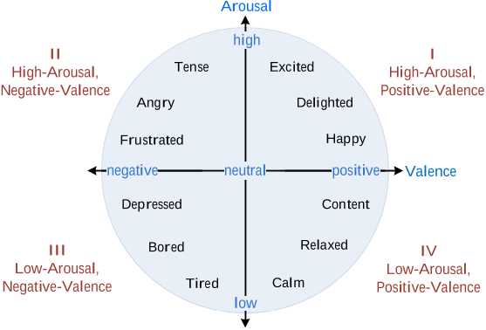
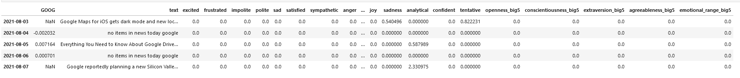
Compute Tones
Each Day’s Text
Compute Document Tone
Compute Sentence Tone
tone_list = ['excited', 'frustrated','impolite', 'polite', 'sad', 'satisfied', 'sympathetic’, 'anger', 'disgust', 'fear', 'joy', 'sadness’, 'analytical', 'confident', 'tentative’, 'openness_big5', 'conscientiousness_big5', 'extraversion_big5', 'agreeableness_big5', 'emotional_range_big5’]
Tone values = 0.5 – 1.
Problems:
Low tones not recorded.
Not enough tones

Slide 7
LSTM
Scale Data
Create 1 day Lagged Data
Split in to 70 /30 For Trian/Test
Simple LSTM
Input Layer
Dense Layer
Compute and plot accuracy
Inverse Scaling and compare predicted test with actual test
Problem: Only 30 days of data

Slide 8
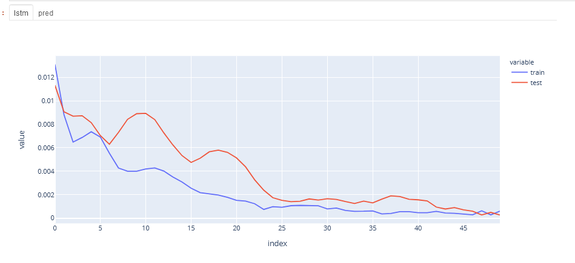
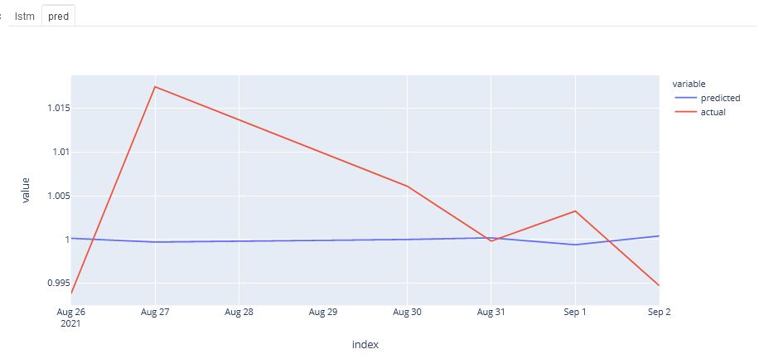
Display
Use Plotly Express to plot data
Use Panel to show multiple outputs
Problem:
Matplotlib hard to do with Panel

Slide 9


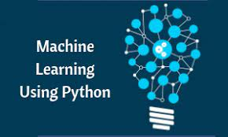
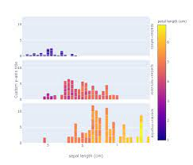
Lessons Learned
Secondary Goal – Use Tools From Class
API
NLP
Machine Learning
Visualization
Most of my time was spent on:
integrating disparate types of data
Hacking the someone else’s library

Slide 10

Future
Get Large Data Set
Additional Exogenous Variables
Correlated/Uncorrelated items
Bond Yields
Additional ML Methods
Regression
Time Series
Reinforcement Learning
Parameterize
Run experiments to determine which methods yield best results

Slide 11
Q&A
It was a Pleasure Studying with All of You!!!

